Slide 1
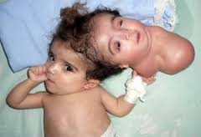
Embryology
Birth Defects
Behrouz Mahmoudi

